Slide 1
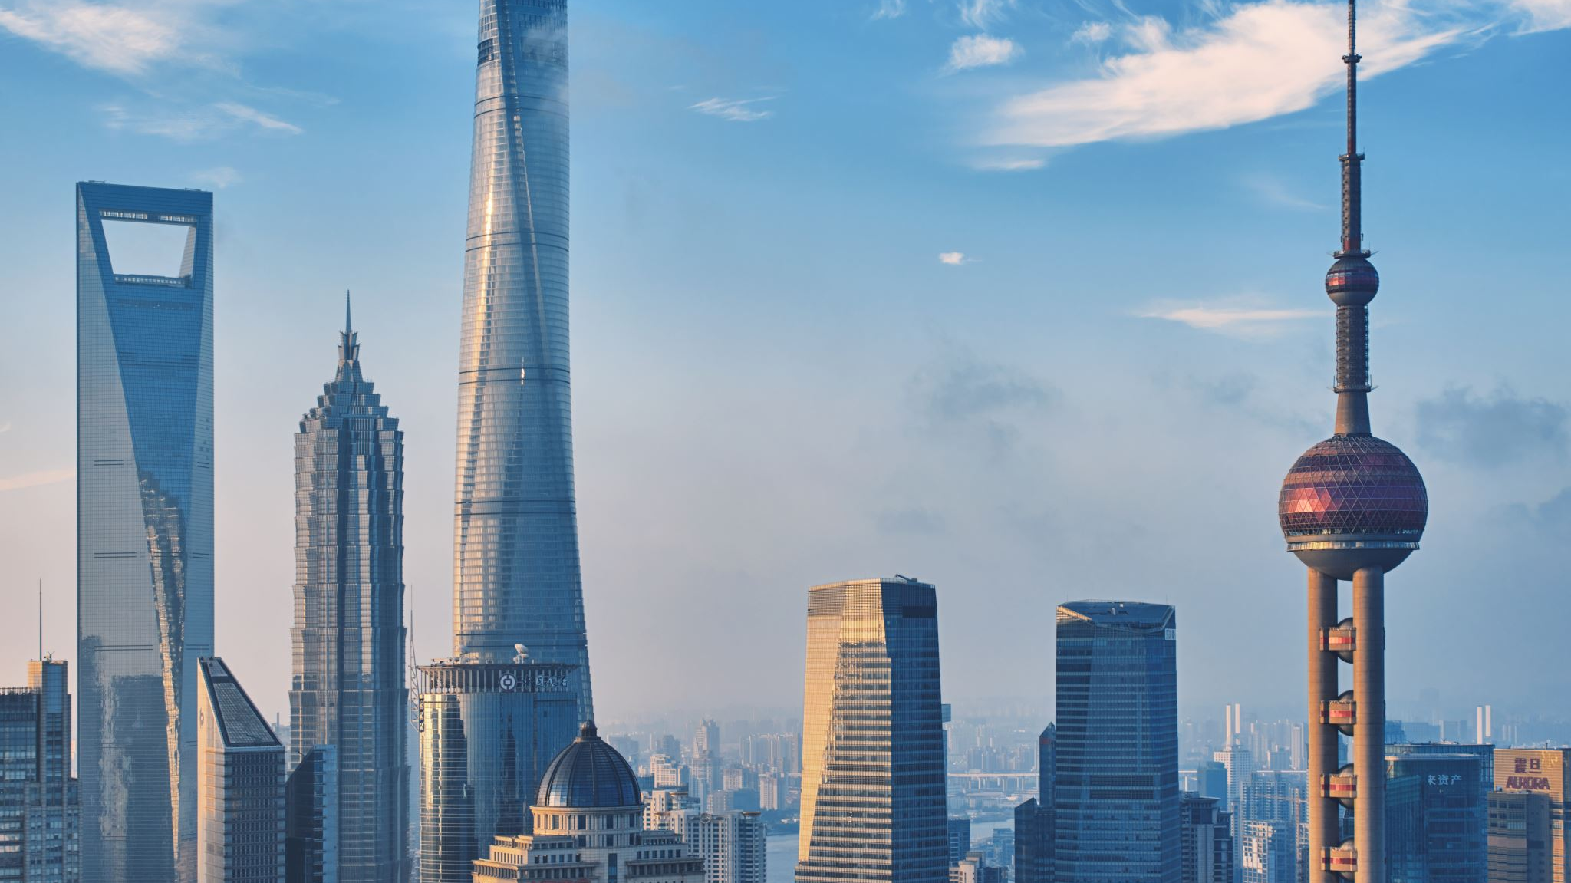
Shanghai districts

Slide 2
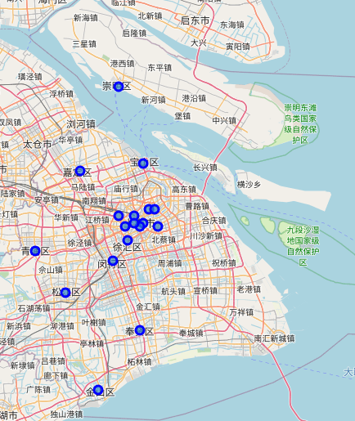
Different districts in Shanghai

Slide 3
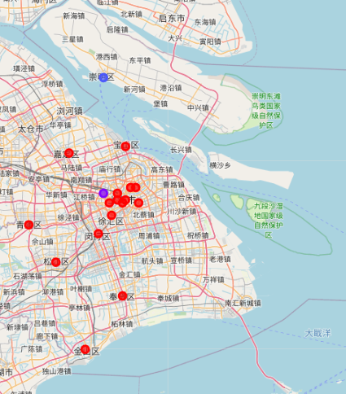
Clusters after k-means clustering

Slide 4
Conclusions
Chongming and Putuo may be interesting for tourists
Rest of the districts are similar to districts in the center

